Slide 1
YAC
Finances and Budget

Slide 2
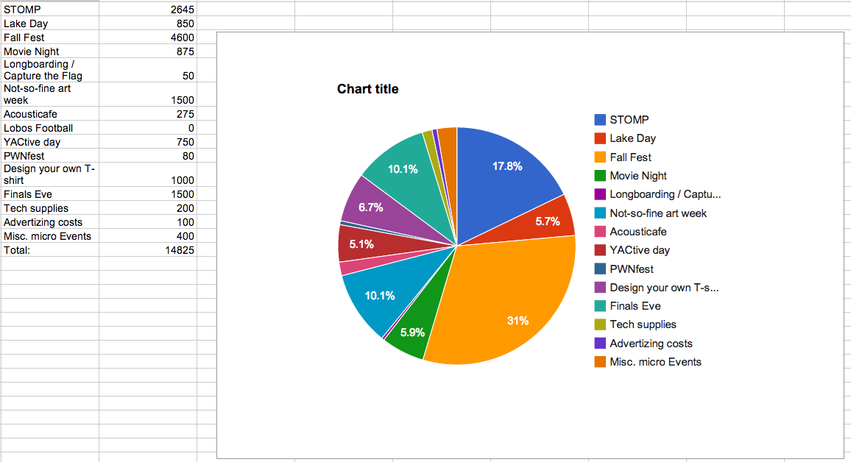
Budget

